Slide 1
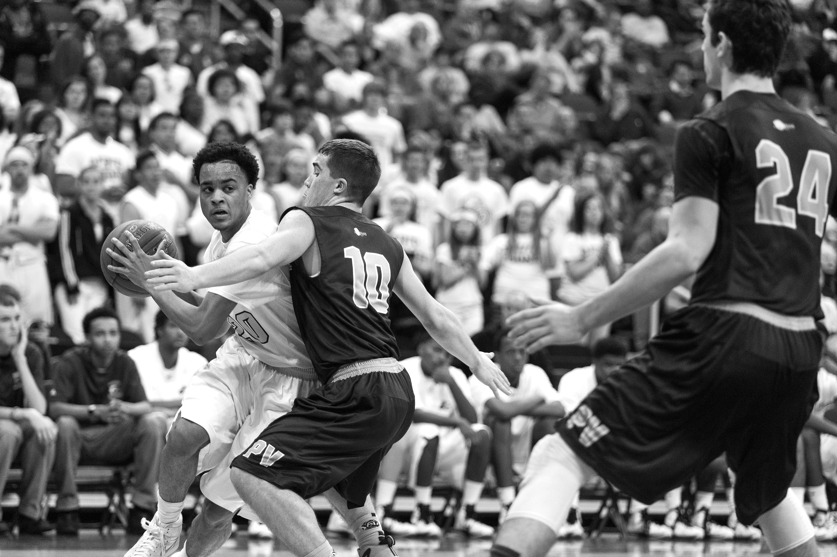

TASK
MADNESS
ON DEMAND
PROCESSING WITH
SPRING CLOUD TASK
TASK MADNESS
ON DEMAND PROCESSING WITH SCT
Notes:
https://www.flickr.com/photos/tabor-roeder/16811793545/

Slide 2
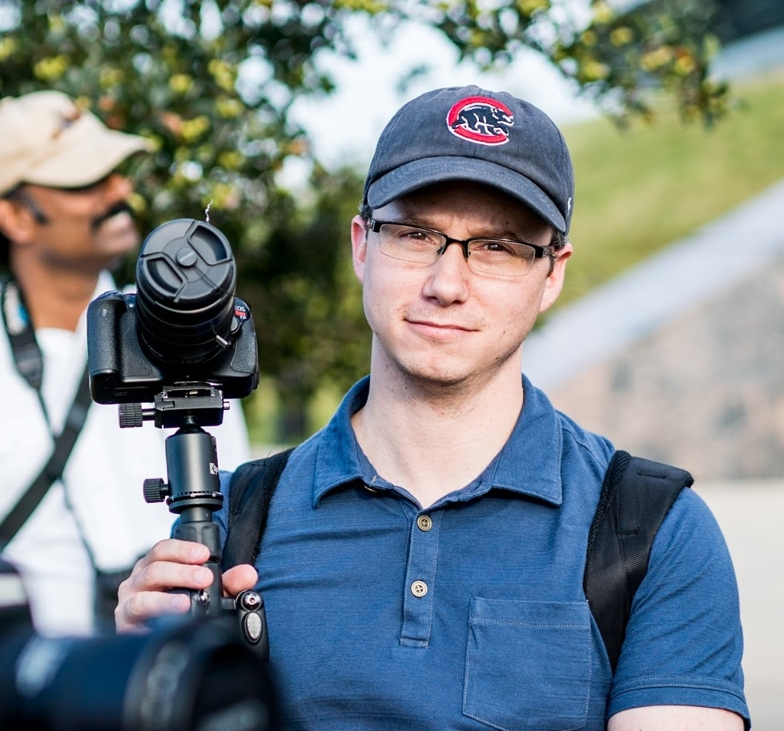
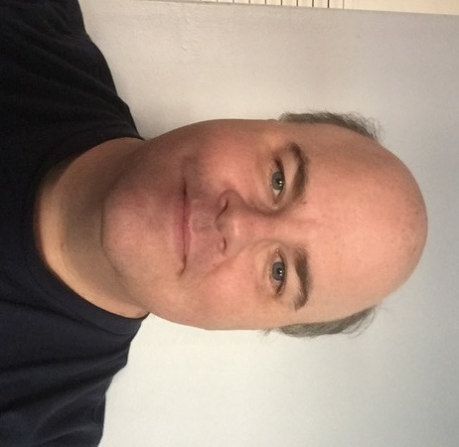
WHO ARE WE?
MICHAEL MINELLA
@michaelminella
@OffHeap
Github: mminella
https://www.spring.io
GLENN RENFRO
@cppwfs
Github: cppwfs
https://www.spring.io

Slide 3
Pivotal is hiring

Slide 4
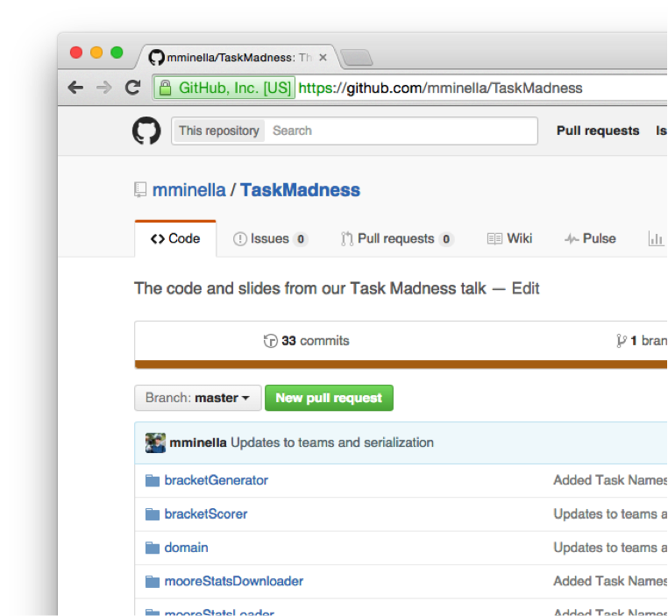

CODE IS ON GITHUB
https://github.com/mminella/TaskMadness

Slide 5


QUICK
POLL

Slide 6
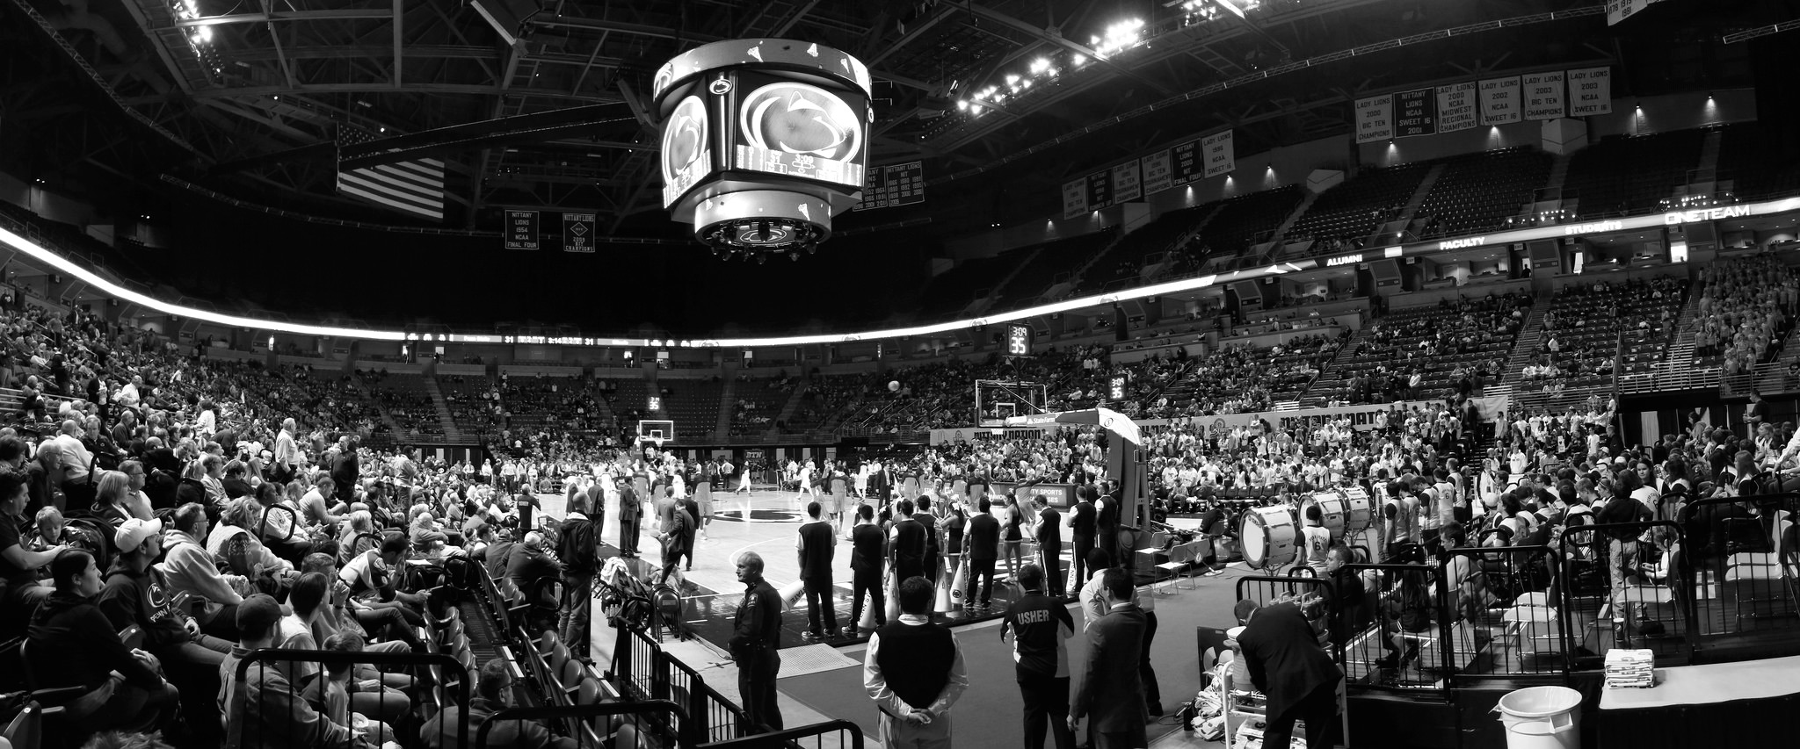
NCAA
MEN’S
BASKETBALL
TOURNAMENT
NCAA Tournament
Notes:
https://www.flickr.com/photos/yuan2003/12959533413/

Slide 7
Infographic for stats on the tournement

Slide 8
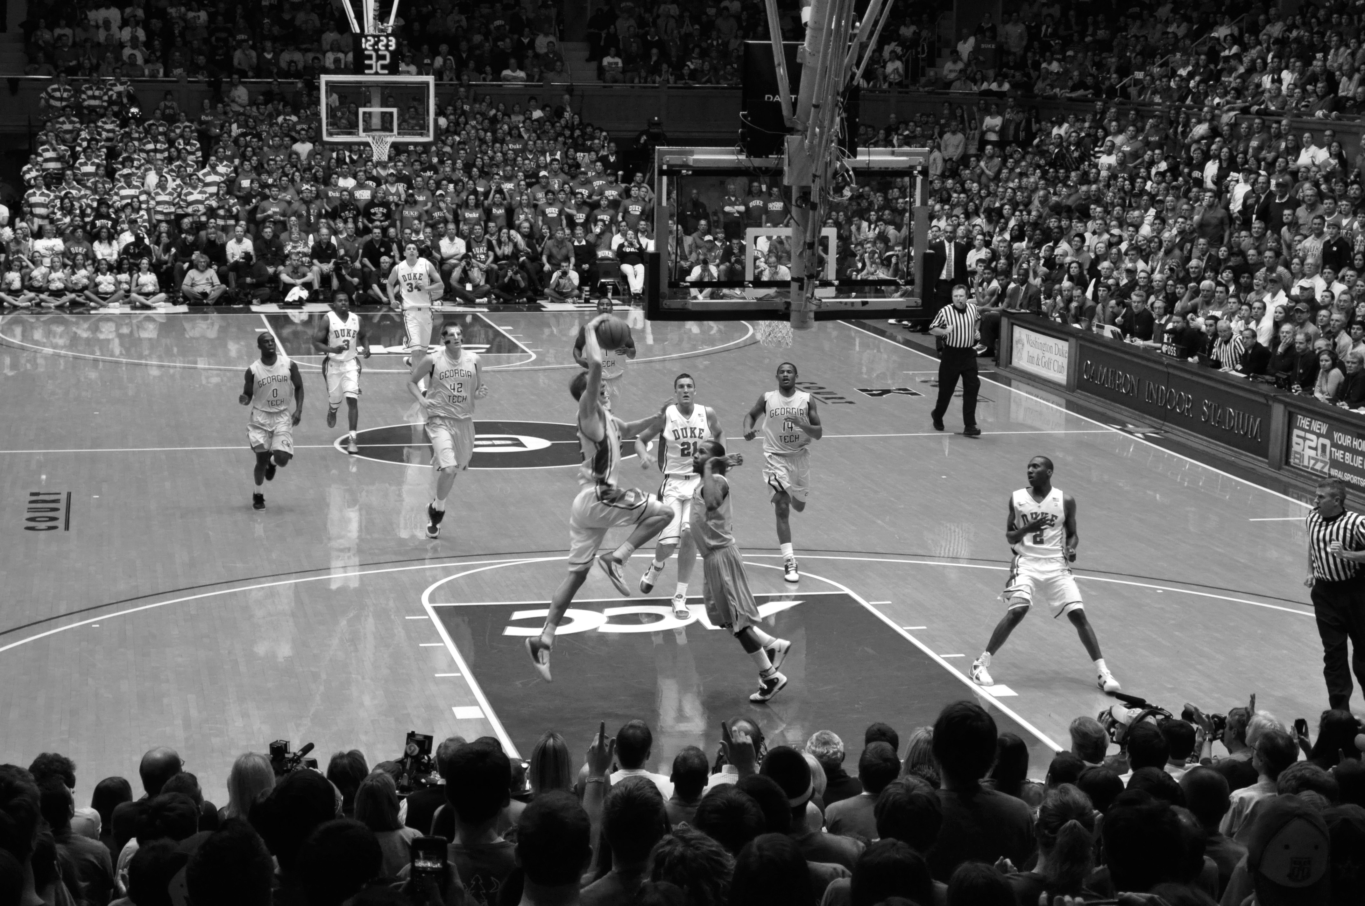

ABOUT THE
TOURNAMENT
Notes:
https://www.flickr.com/photos/whateyesee13/5472188211/

Slide 9
64
TEAMS

Slide 10
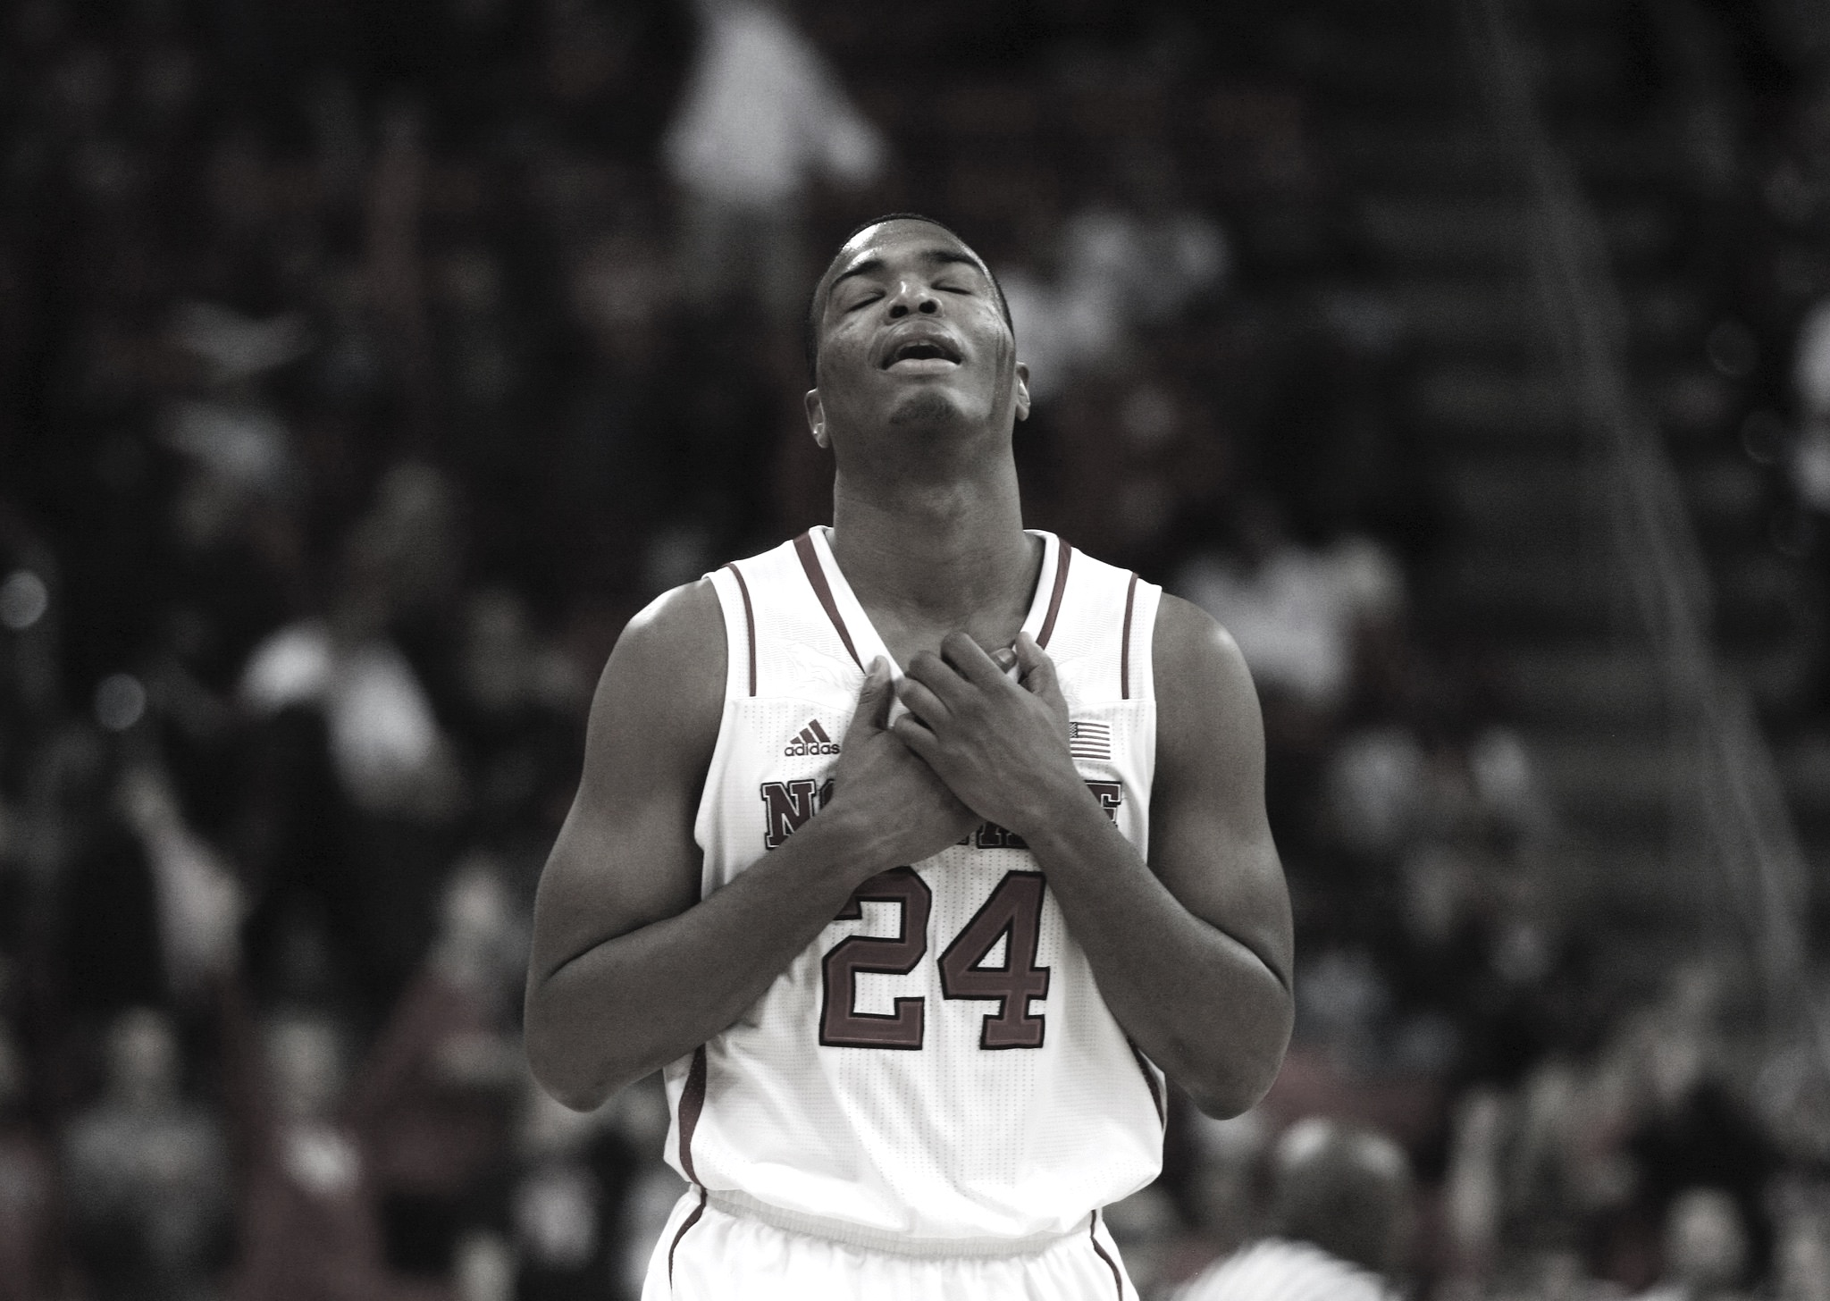

Single elimination
SINGLE
ELIMINATION
Notes:
https://www.flickr.com/photos/romec1/12229748395/

Slide 11
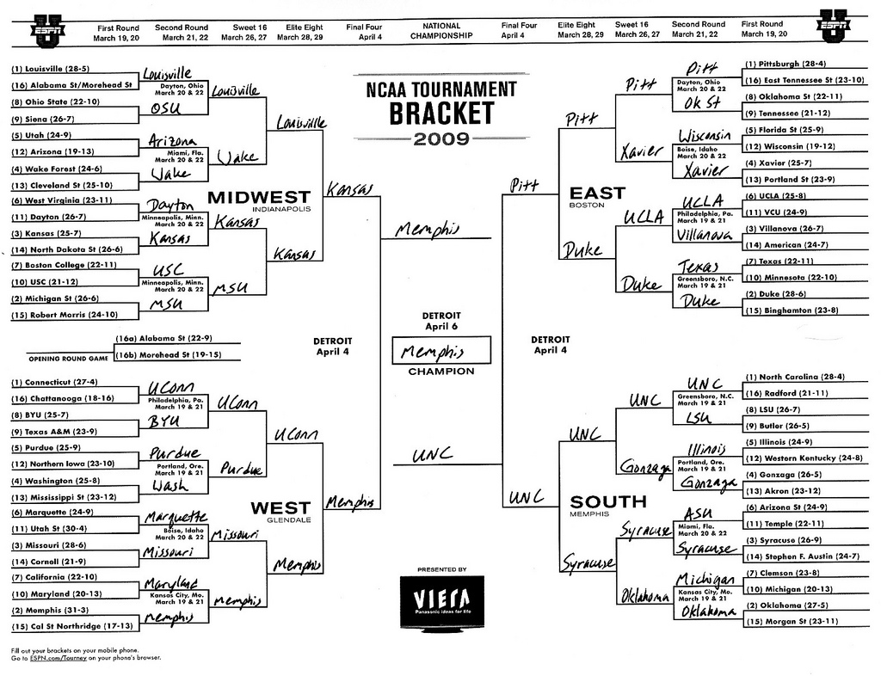
TEAMS
ARE
SEEDED
Teams are seeded

Slide 12
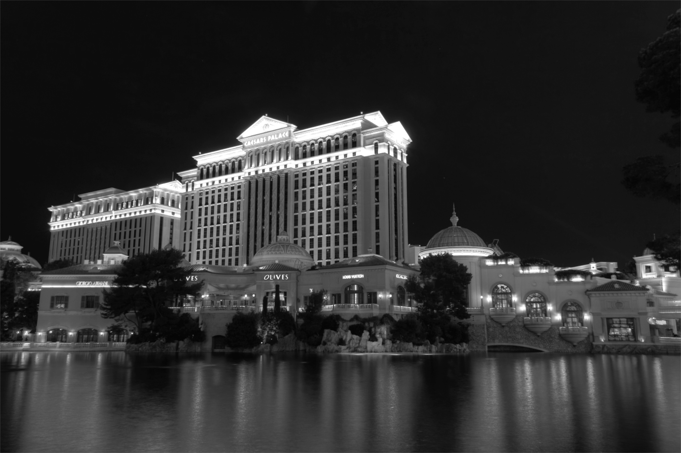

GAMBLING
BASED ON
BRACKETS
Notes:
http://keepingitrealsports.com/wp-content/uploads/2015/03/Obama-Katz.jpg

Slide 13

Not that hard right?
PICK
A PERFECT
BRACKET…
EASY RIGHT?

Slide 14
9 Quintillion possible combinations

Slide 15

NOT
PERFECT
JUST
GOOD
ENOUGH
Notes:
https://www.flickr.com/photos/86530412@N02/7987532186/

Slide 16

WHAT IS
“GOOD
ENOUGH”?

Slide 17

ESPN SCORING RULES
SCORING
RULES

Slide 18
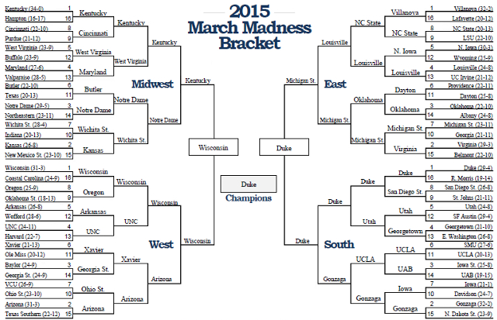
Notes:
3 #1 seeds made the final 4
A #7 seed was the other (that was the “odd” part).
#1 seed (Duke) won

Slide 19
A perfect bracket is 1920
Notes:
320 per round * 6 rounds

Slide 20
Winner scored 1830

Slide 21
Joe Lunardi scored 760 in 2015 and 600 in 2014
Notes:
http://games.espn.go.com/tournament-challenge-bracket/2015/en/entry?entryID=4607369

Slide 22
To crack the top 100 out of the 11 million brackets submitted, you needed 1760
Notes:
2014, a much crazier year…The winner had 1730 and to break the top 100, you needed a 1520

Slide 23
However scores typically have a pretty tight bell curve

Slide 24
We aren’t looking for a perfect bracket

Slide 25
Just one better than everyone else in the office

Slide 26
How are we going to do that?

Slide 27
Use a model to generate millions of brackets

Slide 28
Filter statistically unlikely scenarios out

Slide 29
Score remaining brackets based on other input

Slide 30
Top bracket is “our bracket”

Slide 31
How do we implement this?

Slide 32
Spring Batch!

Slide 33
Not ideal

Slide 34
Different components execute at different times

Slide 35
Different steps should be decoupled

Slide 36
Orchestration should live at a higher level

Slide 37
Distributed deployment options

Slide 38
Develop each component as a microservice

Slide 39
Obey the 12 factor app principals

Slide 40
Just short lived

Slide 41
Introducing Spring Cloud Task

Slide 42
A framework for providing functional and nonfunctional features
for building short lived microservices.

Slide 43
Currently M1

Slide 44
Hello World of Spring Cloud Task

Slide 45
Orchestrating multiple tasks

Slide 46
Image walking through our architecture

Slide 47
Demo

Slide 48
Code!

Slide 49
Roadmap

Slide 50
Spring Cloud Stream integration

Slide 51
Batch integration

Slide 52
Orchestration via Spring Cloud Data Flow
Notes:
Call out tasks replace jobs in SCDF from XD

Slide 53
M2 early next month

Slide 54
GA early Q2

Slide 55
Questions?

Slide 56
Thanks!

Slide 57
CREDITS

